Slide 1
Design
Patterns
by: Clyde Broderick

Slide 2

DESIGN
PATTERNS
What We Will Discuss:
which showcase the best practices used by experienced object-oriented software developers.

Slide 3
CREATIONAL
PATTERNS
They encapsulate knowledge about which concrete classes the system uses.
Hides how instances of classes are created and put together.
Eager vs. Lazy Initialization.

Slide 4
Singleton Pattern
One of the most simple design patterns in Java. One of the best ways to create an object!
Problem - Ensure that a class only has one instance and provide a global access point to it.
Example: ProfileManager profileManager = ProfileManager.getInstance(); //Singleton
Singleton allows you to design a class as if its use will be non-static (implementing interfaces, extending classes) but accessing it gives the appearance of static operations.
Solution: the instance of Singleton Class is created at the time of class loading.
Consequence: Instance is created even if client application might not be using it.

Slide 5
Factory Pattern
A method which is responsible for instantiating and returning an object.
Provides an interface for creating families of related or dependent objects without specifying their concrete classes.
Informal pattern in which there exists a class solely responsible for creation of another.

Slide 6
Builder Pattern
Builds a complex object using simple objects and using a step by step approach.
Problem: Separate the construction of a complex object from its representation so that the same construction process can create different representations.
Resolves issues with large construction involving a lot of attributes.
Example: Consider an application wherein a License can consist of many different fields, often having null values.
Builder construction can be difficult to read and null values must be explicitly initialized.

Slide 7
STRUCTURAL
PATTERNS
Eases design by identifying ways to realize relationships between entities while reducing code-redundancies.
Facade Pattern
Decorator Pattern
Adapter Pattern
Proxy Pattern

Slide 8
Facade Pattern
Provides a simplified interface to a larger body of code, such as a class library.
Prevents client from accessing additional methods that may lead to unexpected user-error.
LIMITS rather than EXTENDS functionality of an encapsulated object.
Consider the case where a client needs to keep a collection of items, but only needs to publicly expose 6 methods: add, remove, get, size(), foreach …

Slide 9
Decorator Pattern
Attach additional responsibilities to an object dynamically.
Provides a flexible alternative to subclassing for extending functionality.
Redundancies from this design are preventable by decorating Profile with a Player. Example being: public class Player extends Profile {

Slide 10
Adapter Pattern
Adapter pattern works as a bridge between two incompatible interfaces.
Converts interface of a class into another interface expected by client.
Allows classes to work together that couldn’t otherwise because of incompatible interfaces.
Example: Consider the case where a client needs to derive a Date from a LocalDate object.
Defining an Adapter Class:

Slide 11
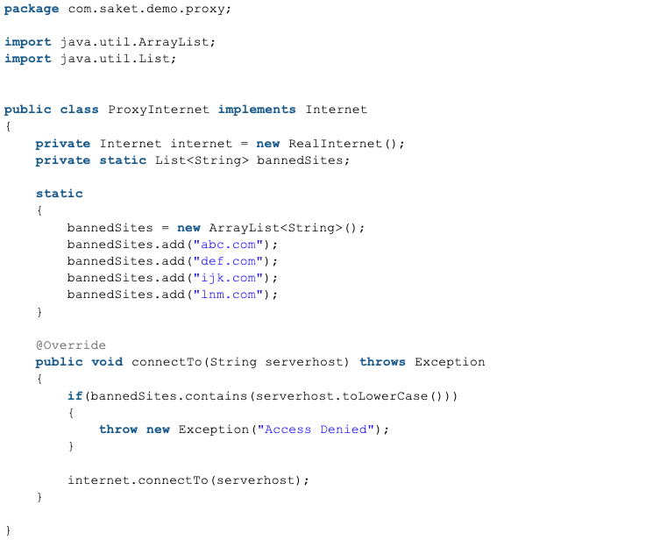
Proxy Pattern
Proxy means ‘in place of’ or ‘on behalf of’.
Proxies are also called surrogates, handles, or wrappers. Avoids duplication.
A real world example is a check or credit card can be a proxy for our bank account. It can be used in place of our cash.
One of the advantages of proxies is its security.
Remote Proxy
Smart Proxy
Virtual Proxy
Protection Proxy

Slide 12
BEHAVIORAL
PATTERNS
Characterizes the ways in which classes or objects interact and distribute responsibility.
Concerned with algorithms and the assignment of responsibilities between objects.
Describe object/class patterns as well as the resulting communication patterns between them.

Slide 13
Strategy Pattern
Concepts
Eliminate conditional statements
Behavior encapsulated in classes
Difficult to add new strategies
Client aware of strategies
Client chooses strategy and knows different Strategies
Class per Strategy

Slide 14
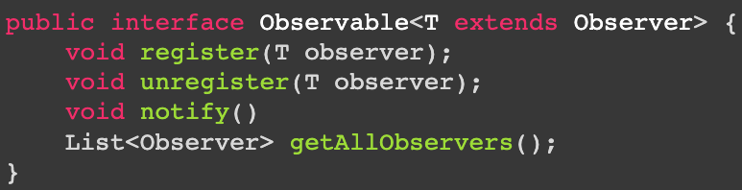
Observer Pattern
Concepts: One to Many Observers, Decoupled, Event Handling, Pub/Sub, M-V-C
Subject that needs to be observed.
Interface or Abstract class from which concrete implementation derive.
Observable - responsible for notifying registered observer’s of state-change and updating.
Summary: Decoupled communication, built in functionality, used with mediator.

Slide 15
Template Pattern
Create a method of high degree of freedom to define methods of lesser variability.
Degree of freedom is determined by the number of arguments of a method.
public static Integer [] getRange (inst start) { //degree of 1
public static Integer [] getRange (inst start, int stop) { //degree of 2
public static Integer [] getRange (inst start, int stop, int step) { //degree of 3

Slide 16
Command Pattern
Command Interface
Decoupling “what is done” from “when it is done.”
Concrete commands objects are tasks; i.e. - UNDO_TASK.
“You’ll see command being used a lot when you need to have multiple undo operations.”
To implement the undo, all you need to do is get the last Command in the stack.
Components of Command Pattern =
Command Interface, Receiver Class, Invoker Class, Client Class

